Slide 1
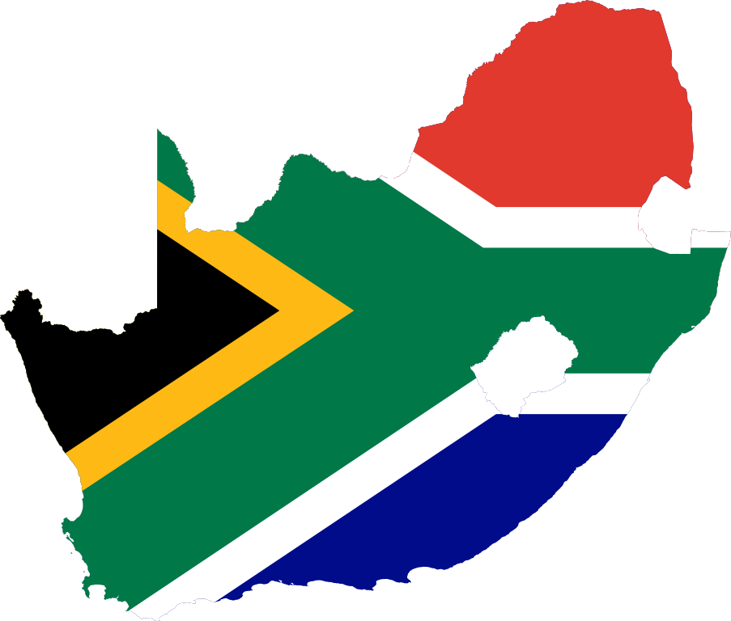


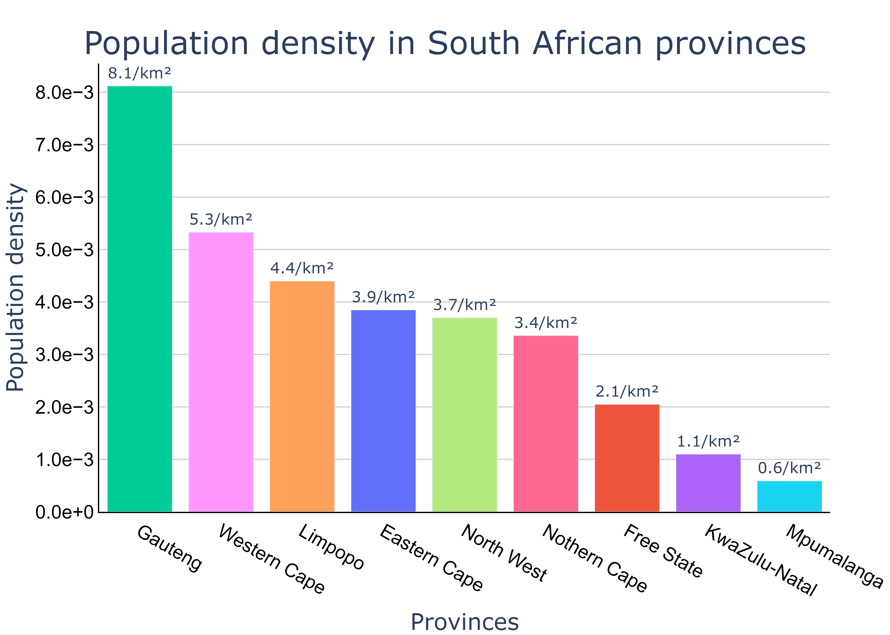

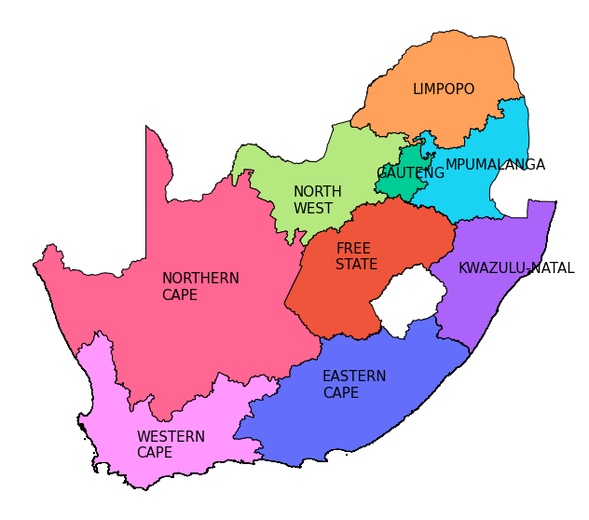
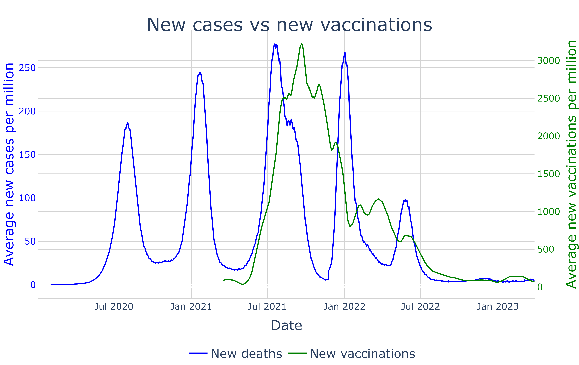
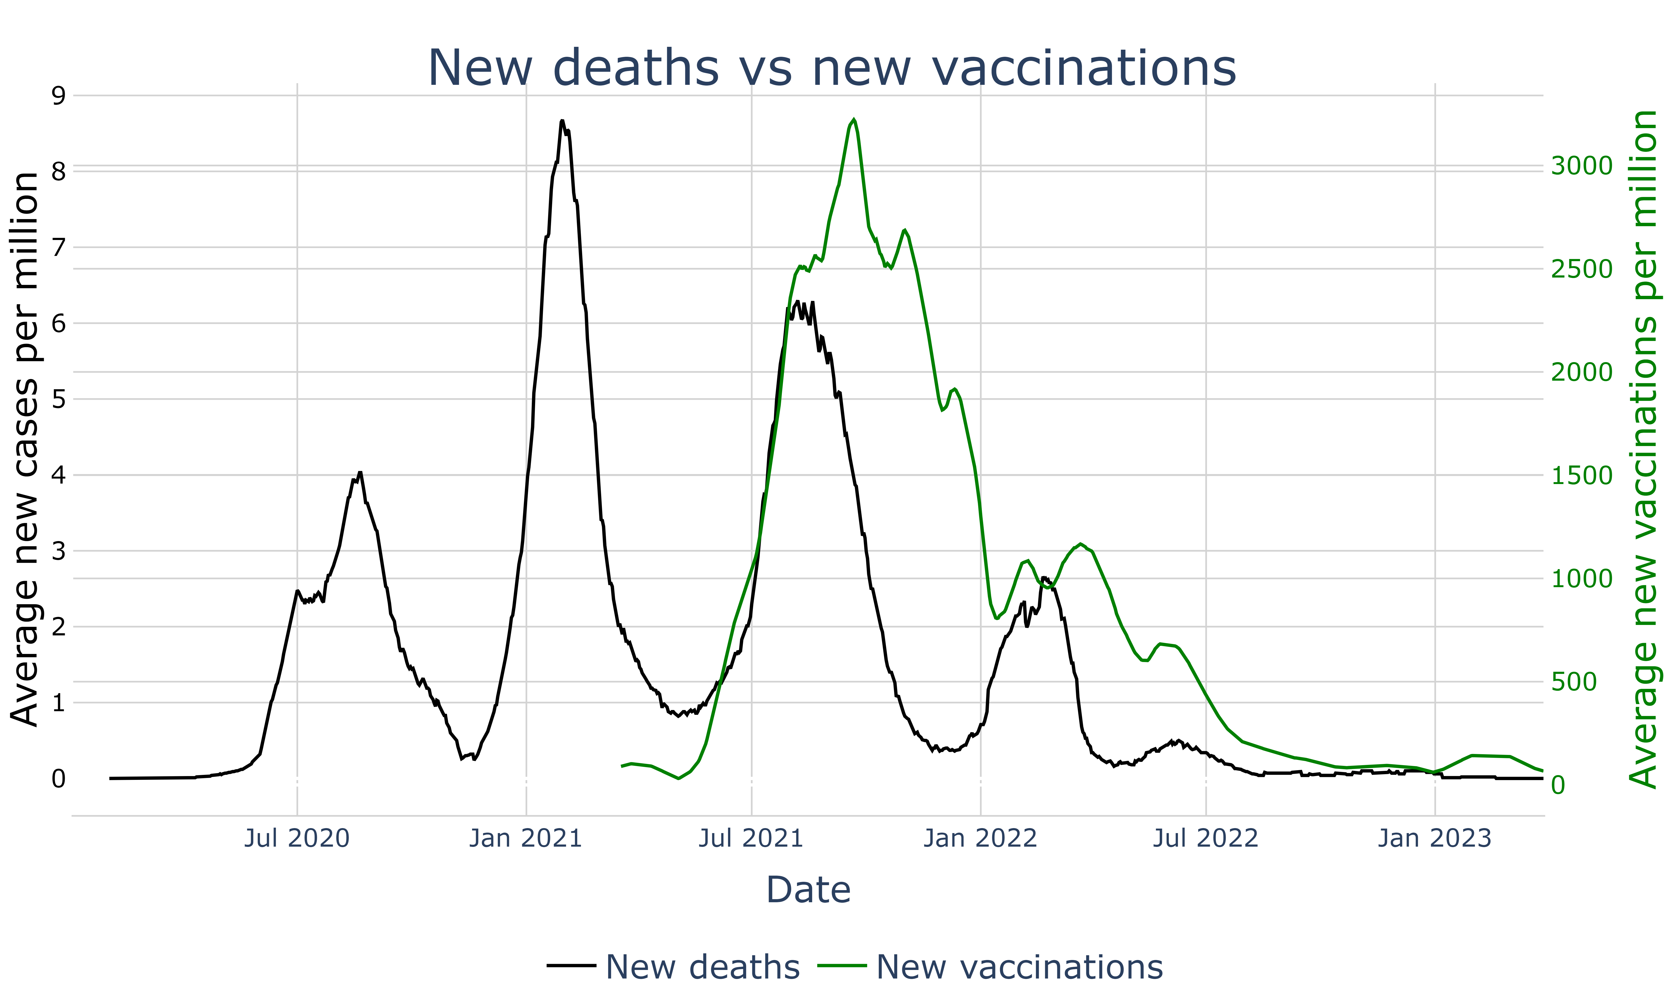
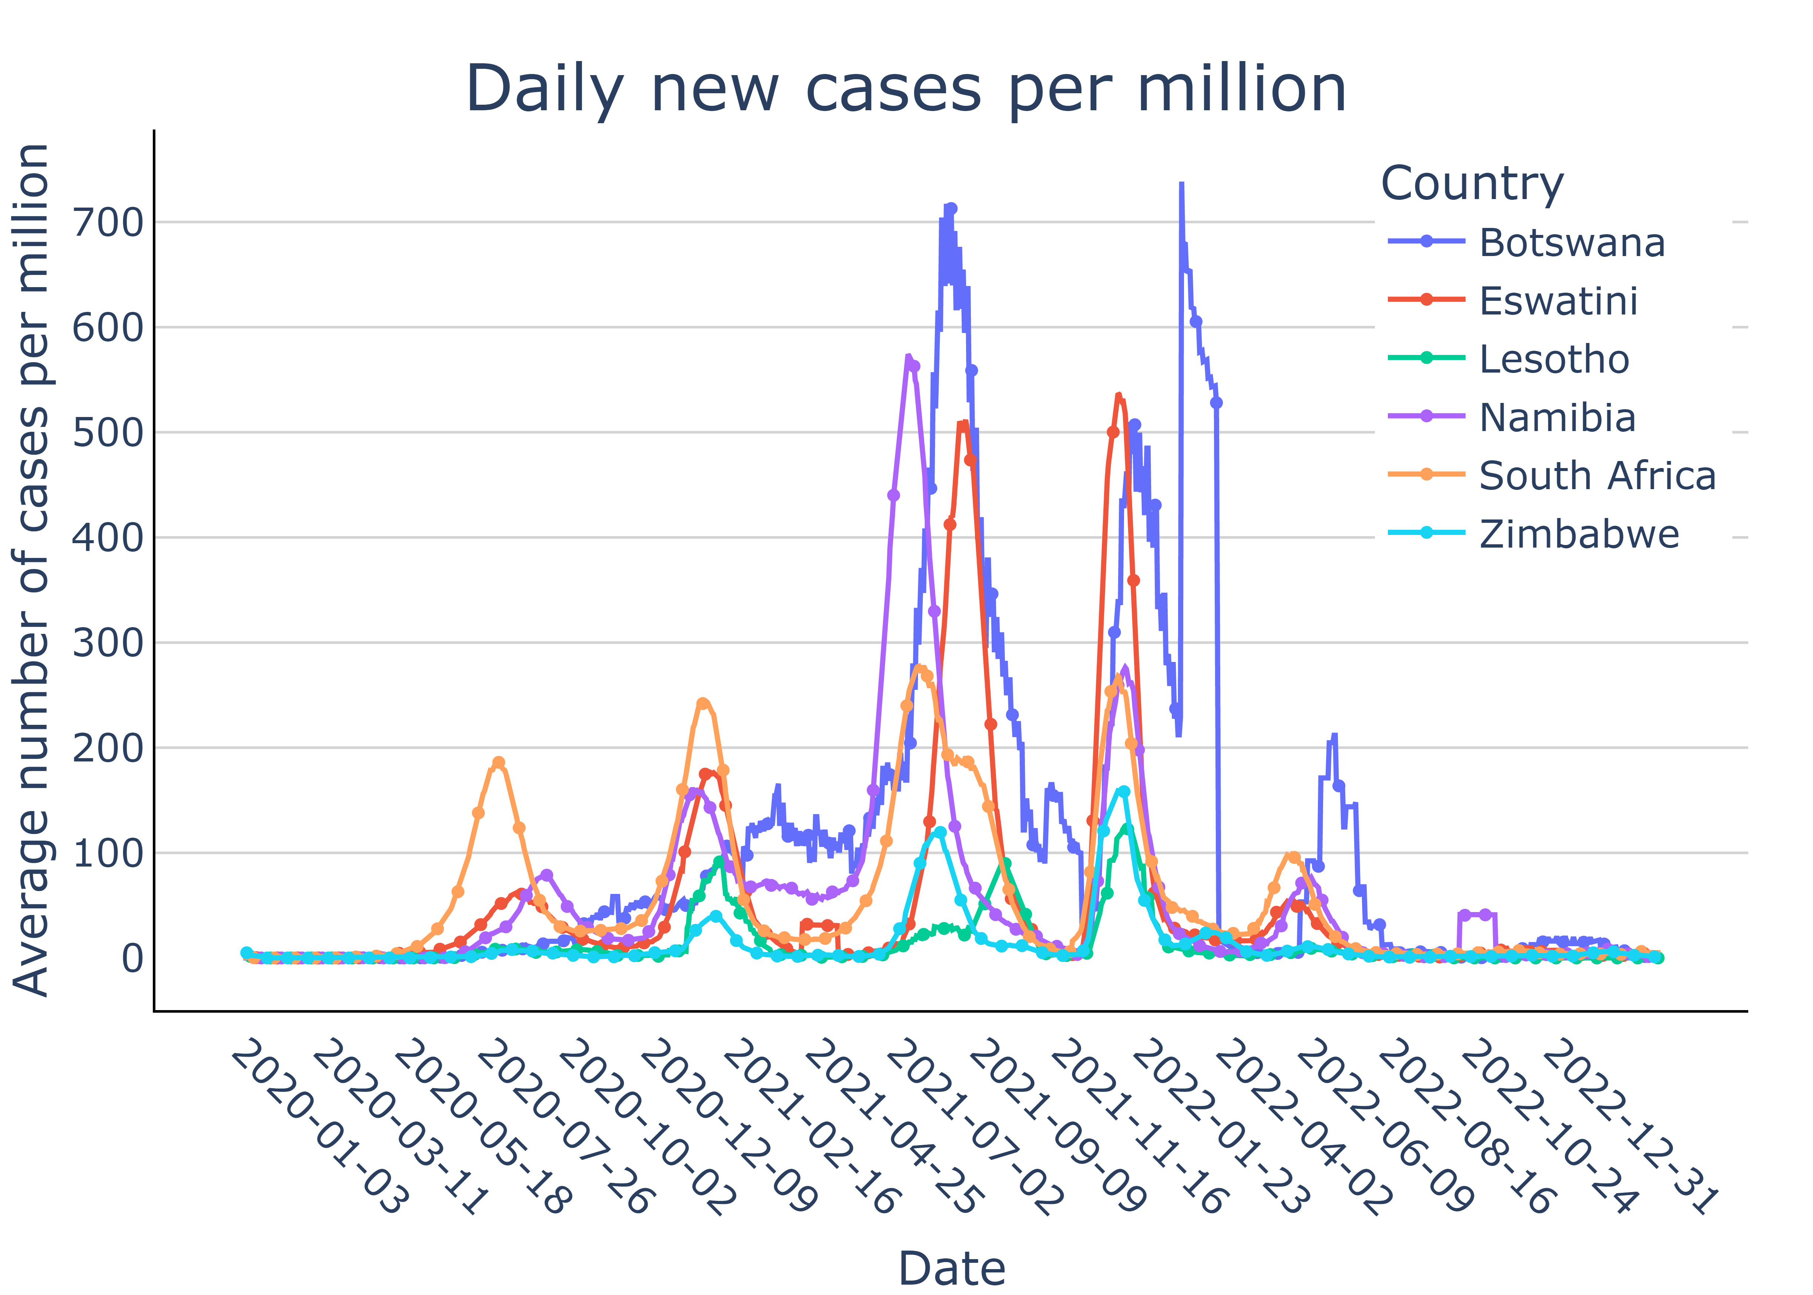
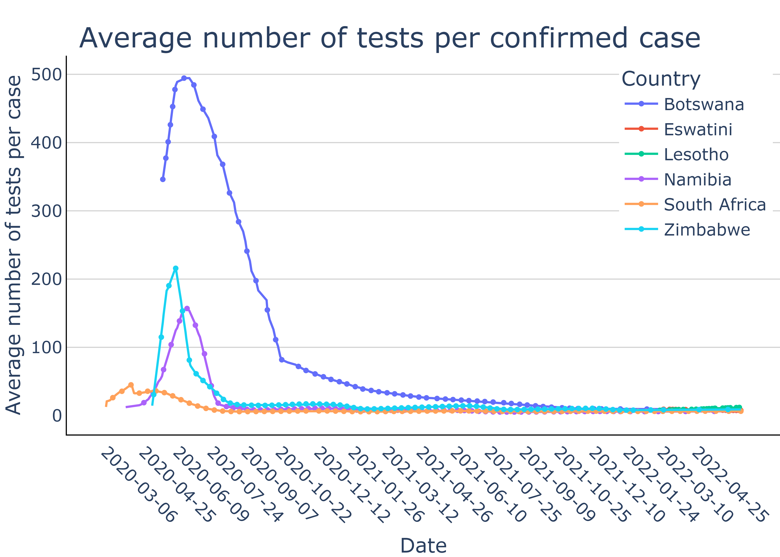
COVID-19
CASES
PEOPLE
in South Africa
61,467,693
4,072,533
Zosia Kochańska#
Julia Smolik##
Total cases²
Population size²
67960.762
27.6
¹ data as of: 03/29/22
² data as of: 04/21/23
# zk406116@students.mimuw.edu.pl ## js406162@students.mimuw.edu.pl
Total cases per million¹
Median age²
NORTHERN CAPE
COVID-19 cases in the provinces
115,290
WESTERN CAPE
701,877
FREE STATE
216,038
EASTERN CAPE
364,100
NORTH WEST
* data as of: 07/25/22
201,987
LIMPOPO
MPUMALANGA
GAUTENG
KWAZULU-NATAL
159,645
202,162
1,324,948
716,934

